Slide 1

How Good is Survey Measurement? Assessing the Reliability and Validity of Survey Measures
Edgar Chicurel

Slide 2



How good are survey measures?
Flaws of quantitative approaches
Reliability and Validity of survey data.
Generally reliable, but not valid
Main sources of data for Social Science research
Quality is essential
Obtain information from sample of people that adequately represent the whole population

Slide 3
Assessing Reliability
Repeated measures
Var[E1] = Var[E2], the measures are said to be parallel → same reliability of Y1 and Y2
When different scales or metrics not parallel but correlated → congeneric
Internal consistency (ICR) estimates of reliability
Y = T + E → sum it many times Yg = Tg + Eg where Yg = Y1 + Y2 + Y3
Var(T)/ Var(Y) = [Var(Y) - Var(E)] / Var(Y)
Valid only when estimates are valid
Difficult to do in real life respondents would find it repetitive → correlations between answers
How to do it? Implement similar but not identical questions

Slide 4
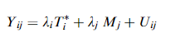
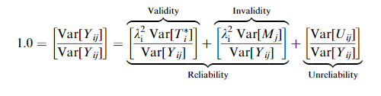
Assessing Reliability and Validity
The Multitrait–Multimethod Approach MTMM
i = trait where M = method factor
j = method

Slide 5
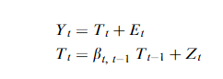
Assessing Reliability and Validity
The Quasi-Markov Simplex Approach
Classical ‘‘test–retest’’ approach
Unrealistic so permit change in the underlying latent variable being measured
Can be further complicated by including multiple informants or raters
Considers systematic errors
Other additions to the model
Scaling variables
Y = Categorical variables

Slide 6

Facts
Survey design characteristics affects variability like adding a don’t know option
Topical series→ “similar following questions” less reliable
Factual content less variation than nonfactual, ex: asking number of kids
Order of questions → “first questions” little bit more reliable than “last”
Appropriate measurement designs make it possible to isolate some types of errors statistically

Slide 7


Thank You

